Slide 1

PCAI Demo Use Case: AI Support Assistant
Dale Georg, Customer Engineer
29 July 2025

Slide 2

Value Proposition
Technical support requests filed by end users can be broadly classified into two groups:
Requests that are fairly common
Many different users hit the same types of issues, or have similar product usage questions
The answers/solutions to these requests can typically be found in FAQs, knowledge base articles, and/or the product documentation itself
The availability of these answers doesn’t stop customers from opening support cases to ask the questions, though
Technical support teams, therefore, end up spending a lot of time responding to the same questions over and over
Unique requests
These typically concern issues that may be specific to a customer’s environment, or to the specific way they are using a product feature that differs from the norm
The unique nature of these issues means that answers are not likely to be found in any documentation
Thus, technical support personnel need to dedicate time and resources to work with the customer on investigating, troubleshooting, and ultimately finding a solution
If we could use AI to triage incoming support requests, and automatically respond to the customer with solutions to the common well-documented issues, this would free up more time for the technical support team to work on the challenging issues,

Slide 3
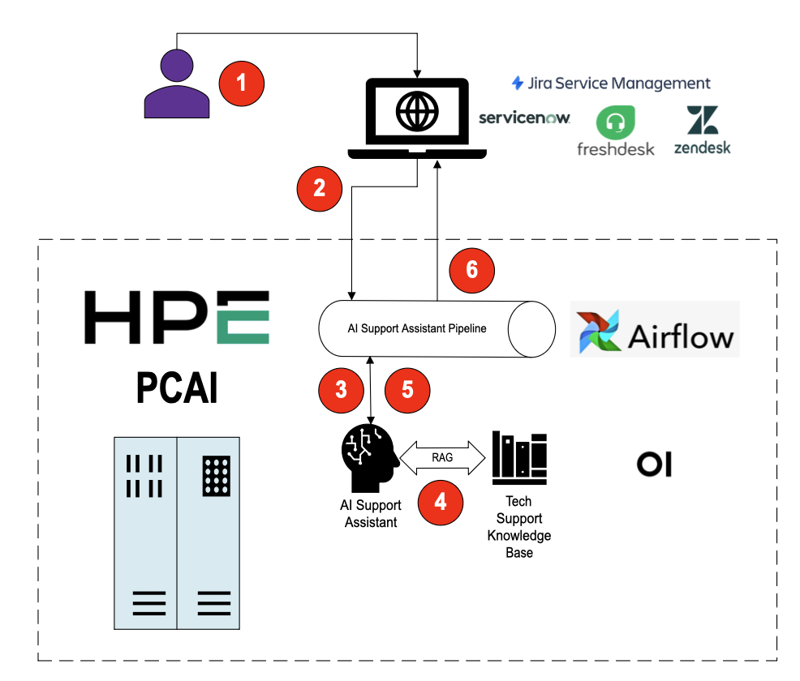
AI Support Assistant – Production Workflow
User opens a new support case in whatever case management system they use
An Airflow pipeline is triggered with the details of the case
The pipeline invokes the AI Support Assistant model running in OpenWebUI
The AI Support Assistant model leverages RAG to search for an answer to the user’s support issue
The AI Support Assistant provides its response to the pipeline
The pipeline updates the support case appropriately

Slide 4
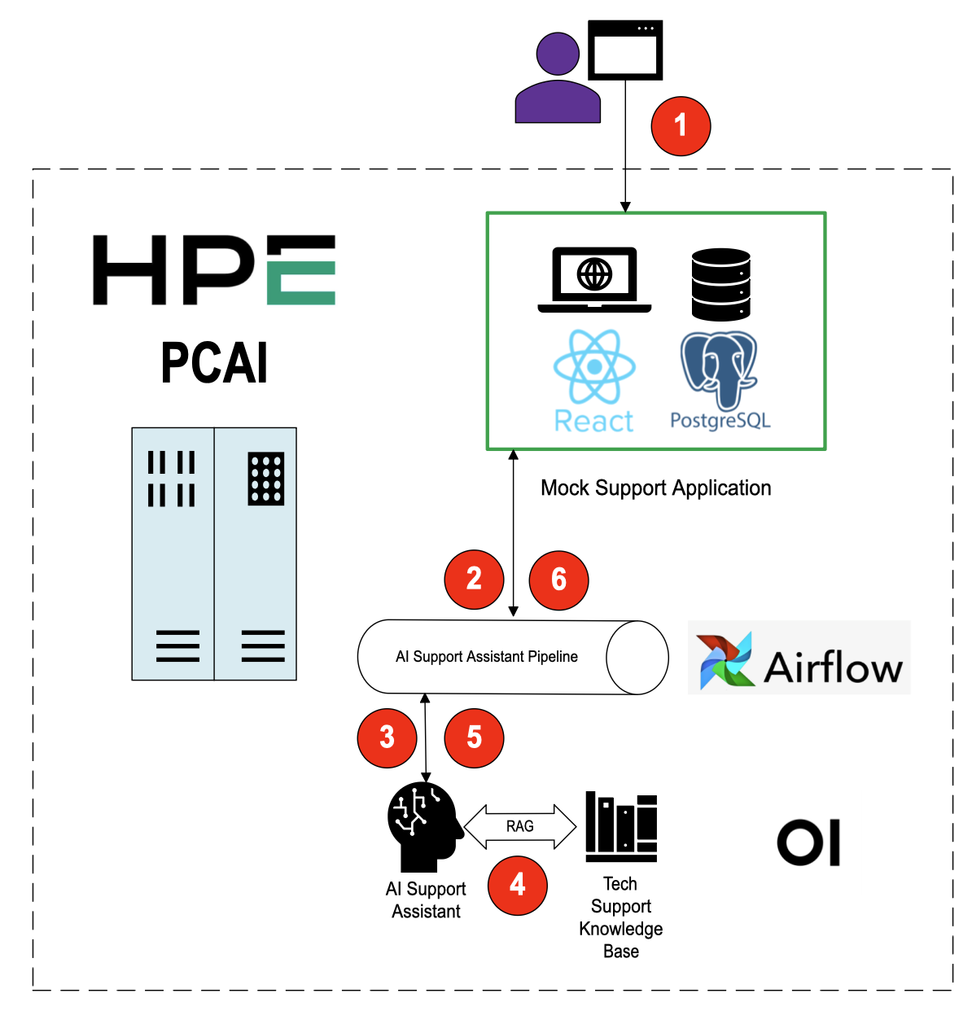
AI Support Assistant - Demo Workflow
For the demo, we use a Mock Support Application to stand in for an actual case management system
The Mock Support Application also runs within PCAI
The core of the workflow is essentially the same, however

Slide 5

Thank you

Slide 6
Resources
It’s important for you to download and use only HPE licensed assets. Please review the following slides for more guidance.

Slide 7
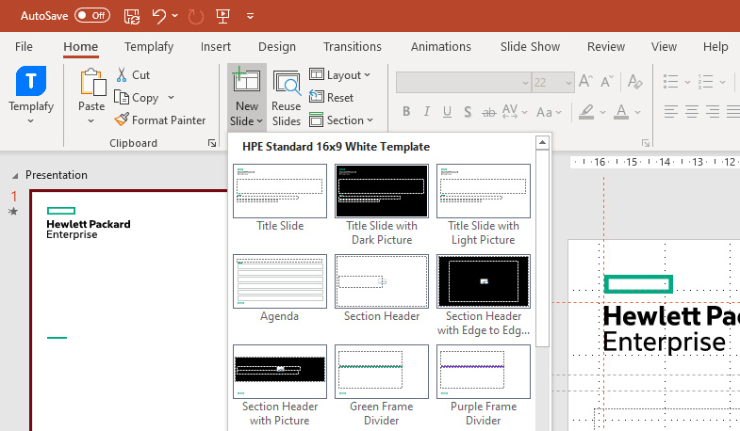
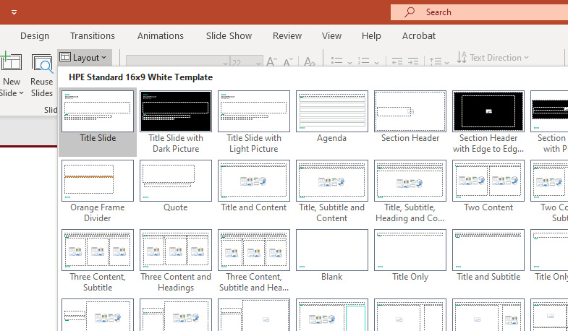
Working with HPE PowerPoint templates
Adding new slide
Click on New Slide and select the layout that best supports your content.
PowerPoint layouts
We have over 45 different layouts available for white and black backgrounds.
Switch layouts by clicking Layout.

Slide 8
Brand Central
This is your one-stop shop to learn HPE brand. Visit this page if you have questions on naming, color, type, icons and many more.
Access Brand Central
Open Support Ticket
Download Inspiration Slide Gallery
Access PowerPoint
Quick Steps
Download Co-Marketing
PowerPoint template
Access Photography guidelines
Access Illustrations
Access Iconography

Slide 9
Legal Guidelines
Please review this section for more legal guidance.

Slide 10
Legal Guidelines for PowerPoint presentations
Third Party Content
Do not use any third party content in your presentations without proper licenses or approvals.
Third party content includes images, music, diagrams, drawings, video clips, illustrations, comics, prose, characters, social media posts, memes, GIFs, or any other content owned or produced by any party other than HPE and for which HPE does not have a license to make use of such content.
Do not procure content from websites that claim to offer royalty-free assets for use for free, under creative commons licenses, from YouTube, or other low cost/free sites.
Do not use any names, trademarks, logos, or other branded materials of or from third parties, including clients, customers, or partners, without first getting the necessary approval and release forms signed by such third party.
If you want to include a reference to a customer or use any of its content, submit a request through the Customer Advocacy References Request Hub.
For other third parties, in most cases the third party would supply forms that should be reviewed by your Commercial BU/Regional Legal Contact. If a third party does not have a form, please consult with Trademarks Legal and your Commercial BU/Regional Legal Contact.
Do not use content if its source is unclear, and do not assume that content found in previous HPE presentations is automatically OK to use for a current project – licenses or other approvals may have expired.
Permissible Content
If possible, obtain all footage/imagery for your presentations through Brand Central.
If you need content that is not available through Brand Central, you should open a ticket in the CRT tool by clicking on the “Open Support Ticket ?” at the top right of Brand Central’s navigation bar and the Brand Team will get in touch with you regarding acceptable options to obtain content, including through trusted sites such as Getty and Pond5.

Slide 11
Legal Guidelines for PowerPoint presentations
Claims Regarding HPE Products/Services
Only make a claim about HPE and our products or services in your presentations if it is true, accurate, fair, complete, and supported by objectively verifiable, reliable, quantifiable, and substantiating information which remains up-to date during the life of the presentation. Retain all such substantiating information.
Screenshots/Demos of HPE Products
Do not use screenshots or provide product demonstrations that contain any HPE (or third party) confidential or proprietary information or any other identifiable information that poses security vulnerabilities (e.g., IP addresses).
When showing screenshots or demos of interfaces, conceal or remove (i) all third party trademarks and logos (e.g., software icons) and (ii) any information that could possibly identify customers, partners or other non-consenting parties (including names, email addresses, phone numbers, etc.).
Presentations at Conferences and Events
If your presentation is for a third party conference or event and you are asked to sign any release form or other document, you must first engage Trademarks Legal and your Commercial/Regional BU Legal Contact for approval. Please also contact Jeff Askew on the Brand Team before you grant any third party the right to use the HPE logo at an event, as a Display Authorization Agreement must be executed if the Brand Team approves.
HP Inc. Brand Identity
All elements of the HP Inc. brand identity must be retired and not used in any HPE presentation. This includes but is not limited to: HP logo, product images/photography/b-rolls showing HP logo, HP color palette and fonts.
If you have any questions reach out to your BU Commercial Attorney, and they can reach out to Trademark Legal, if necessary.

Slide 12
Disclosure Statement
Audience | Disclosure Statement | Guidelines
Use for training HPE Employees, Outsourced, Channel Partners and Customer Education training material | Confidential – For Training Purposes Only | Can only be shared on PSNow and Seismic Not to be uploaded on HPE.com or public platforms Not to be shown to the customers, or share with customers either digitally or as print copies
If the document is for HPE employees and partners who have agreed to keep it confidential and is not to be shared with customers, label it | Confidential | Authorized HPE Partner Use Only | Can be shared on PSNow and Seismic Not to be uploaded on HPE.com or public platforms Can be shown to customers either digitally or as print copies (need to include in the description that a CDA* is required to share with the customer) and not to be left behind
If the document is for HPE employees and is not to be shared with customers or partners, label it | HPE Internal Use Only | Can only be shared on PSNow, Seismic (Internal employees) Not to be uploaded on HPE.com or public platforms Not to be shown or handed over to partners or customers either digitally or as print copies
If the document can be shared with customers or the general public and does not have any confidential or proprietary information | No Document Label Needed | Can be uploaded both on PSNow and Seismic Can be shown to customers/partners either digitally or as print copies Document will be searchable through search engines. To avoid, use it as Gated Asset or stage your release dates
Presentation for events | No Document Label Needed | Can be uploaded both on PSNow, Seismic, and public platforms Can be handed over to customers/partners either digitally or as print copies Document will be searchable through search engines. To avoid, use it as Gated Asset or stage your release dates
* Please refer to next slide

Slide 13
Confidential Disclosure Agreement
The information contained in this presentation is considered Confidential Information of Hewlett Packard Enterprise (HPE) and is subject to the Confidentiality terms and conditions in your HPE vendor or partner agreement
This presentation may be shared with HPE Authorized Service Providers and Channel Partners in hard-copy or electronic format for their internal training purposes only
This presentation is NOT to be used as a ‘leave behind’ for HPE external customers
The information in the presentation may only be shared verbally with HPE external customers who are under CDA and should NOT be used for commercial purposes
Do not remove any classification labels, warnings or disclaimers on any slide or modify this presentation to change the classification level
Do not remove this slide from the presentation
HPE does not warrant or represent that it will introduce any product to which the information relates
The information contained herein is subject to change without notice
HPE makes no warranties regarding the accuracy of this information
The only warranties for HPE products and services are set forth in the express warranty statements accompanying such products and services
Nothing herein should be construed as constituting an additional warranty
HPE shall not be liable for technical or editorial errors or omissions contained herein
Strict adherence to the HPE Standards of Business Conduct regarding this classification level is critical

